Slide 1
Schedule Scans with iLab
A USER INTRODUCTION
KATHLEEN DURKIN , M.S.
Director, MR Research Administration

Slide 2
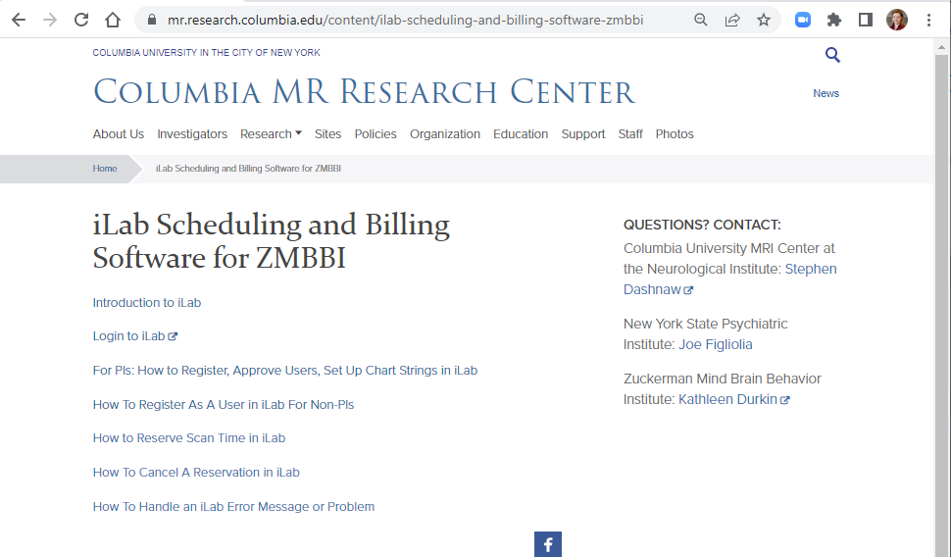
ALL iLAB INFO
https://mr.research.columbia.edu/content/ilab-scheduling-and-billing-software-zmbbi
Notes:
I will email this; no need to write it down.

Slide 3
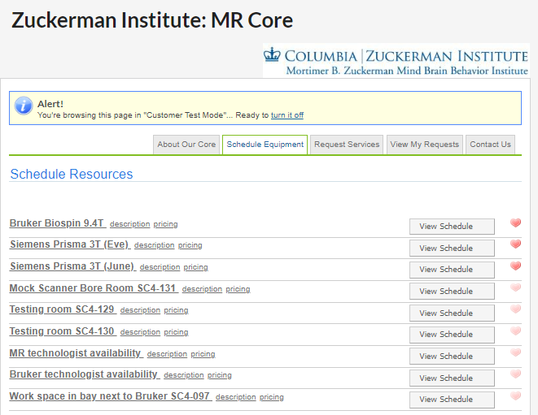
WHAT IS iLAB?
iLab has the calendars for Zuckerman Institute MR resources.
-One Bruker Biospin 9.4T system
-Two Siemens Prisma 3T systems (“Eve”, “June”)
-One mock scanner room
-Two testing rooms
-the MR Technologist Availability calendar
-the Bruker Technologist Availability calendar
-Work Space in SC4-097 calendar
Notes:
I’ll give you access to the calendars you need so you probably won't see all of them when you log into iLab.

Slide 4
WHO NEEDS ILAB ACCESS?
The lab member(s) in charge of scheduling
Any other lab member who might want to keep an eye on the calendar (maybe a PI or lab manager) or check billing (maybe a financial manager)
iLab access is given by request only.
Next: how to get it!
Notes:
You may not need access to iLab. But if you're reading these slides today, you probably do.

Slide 5
HOW DO I GET ACCESS?
To get started in iLab you need to have:
Completed your MR Safety Training
A UNI
A iLab account
A chartstring
Contact Kathleen Durkin at kd2649@columbia.edu to set you up in iLab.
Notes:
Safety training… for a calendar? Yes. We have found it helps to keep calendar access limited to people who will be coming here to work with the systems. It’s a safeguard for the labs. If Person A needs to attend the scan, it’s best if Person A books the scans. We make exceptions when requested, as long as a lab accepts the risk of opting out of this safeguard.
If you lack a UNI, Kathleen can help you get one.
(Create a New Account instructions provided on the website https://mr.research.columbia.edu/sites/default/files/content/How%20To%20Register%20As%20A%20User%20in%20iLab%20For%20Non-PIs.pdf)
(How Your PI Can Give You Access to a Chart String instructions provided on the website https://mr.research.columbia.edu/sites/default/files/content/For%20PIs%20How%20to%20Register,%20Approve%20Users,%20Set%20Up%20Chart%20Strings%20in%20iLab%20NEW%20IMPROVED.pdf)

Slide 6
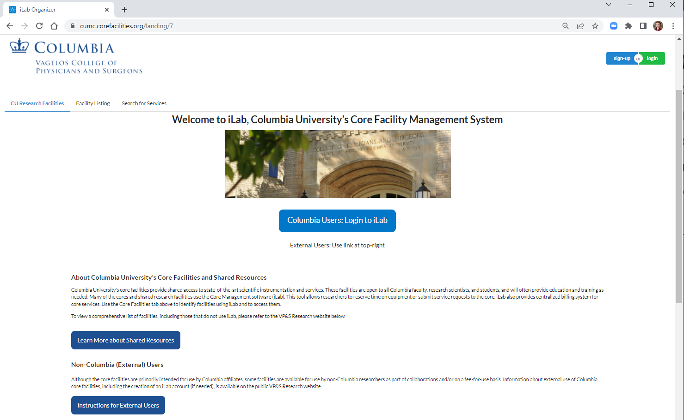
Now your iLab account is set up.
Before you schedule a scan, gather this information:
who will be at the scan: one person to operate the scanner (either the MR Technologist, or a Level III lab member) and one other Level II or Level III person
which chart string will pay for the scan
the name of the participant
Then log in!
Notes:
Sometimes people book time before they have a specific participant in mind. We generally discourage this because it makes it harder for the researcher, but it’s not against the rules.

Slide 7
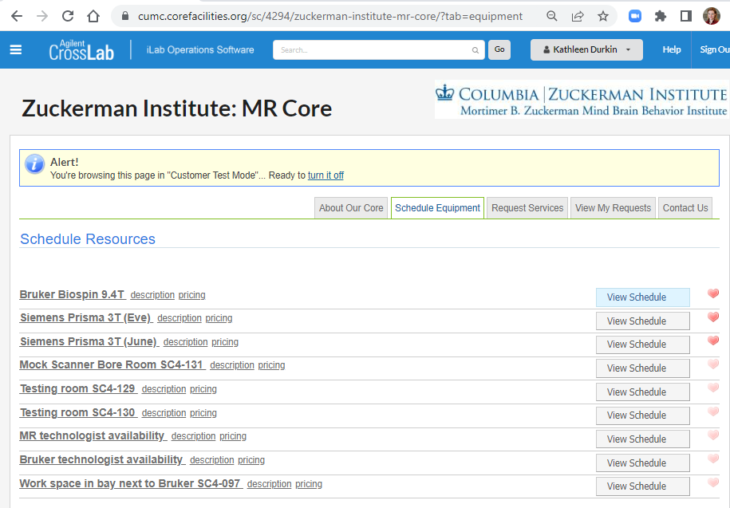
Select the “Schedule Equipment” tab.
Select your calendar.

Slide 8
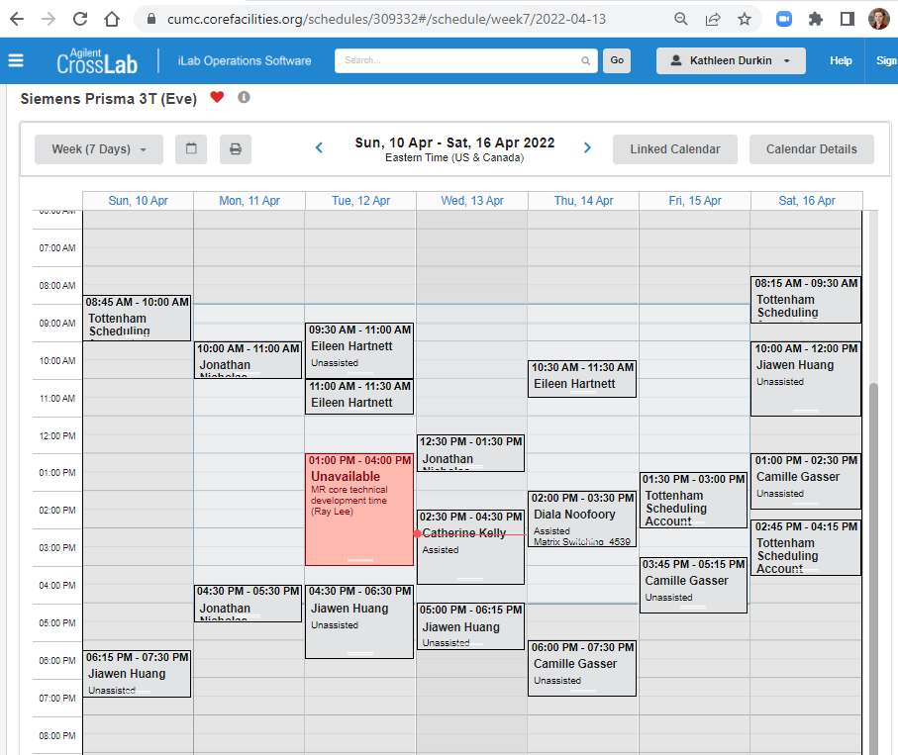
2. See what time is available that will work for you and your participant. Remember: you’ll need to leave at least 15 min between scans.
Have a few times and dates in mind. THEN check MR Technologist Availability calendar before booking the time!
Notes:
Used to require 30 min between scans for airing out, but as of May 23 2022 that has been cut to 15.

Slide 9
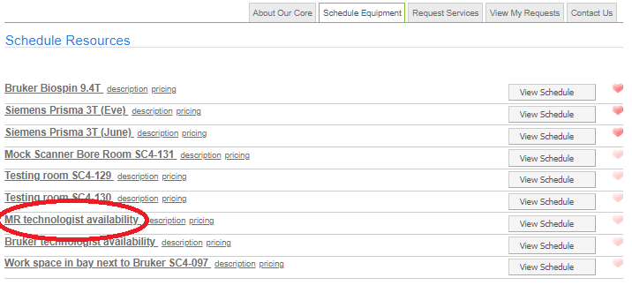
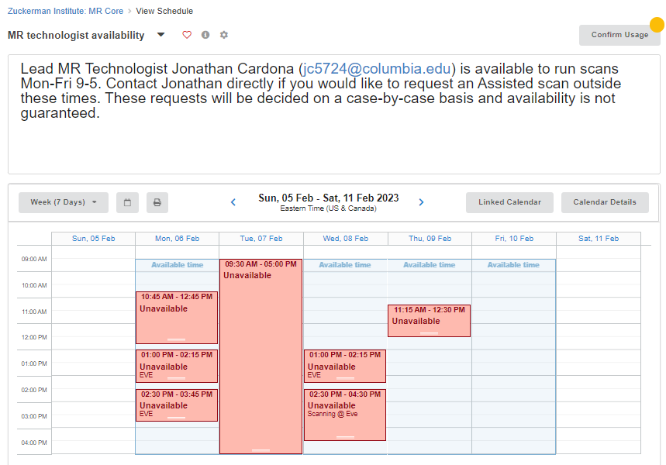
3. IMPORTANT: if you need to work with the MR Technologist, check to see if he’s available on the MR Technologist Availability calendar BEFORE booking your time on Eve or June.

Slide 10
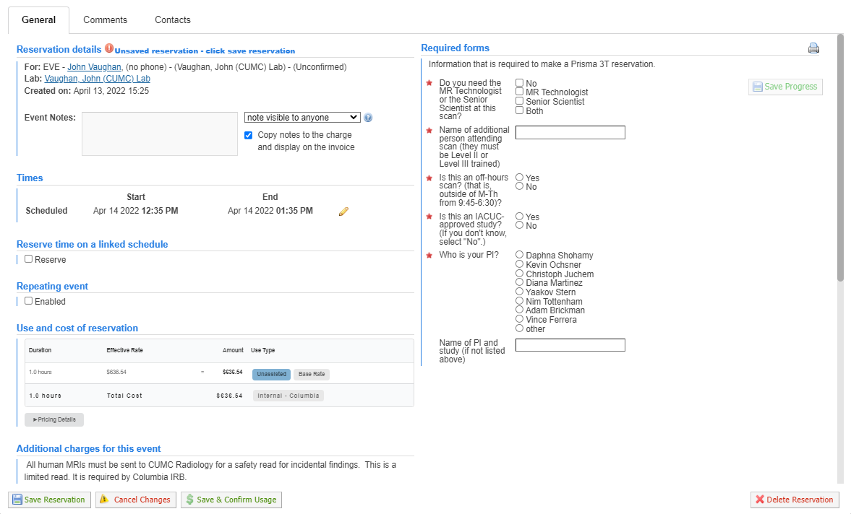
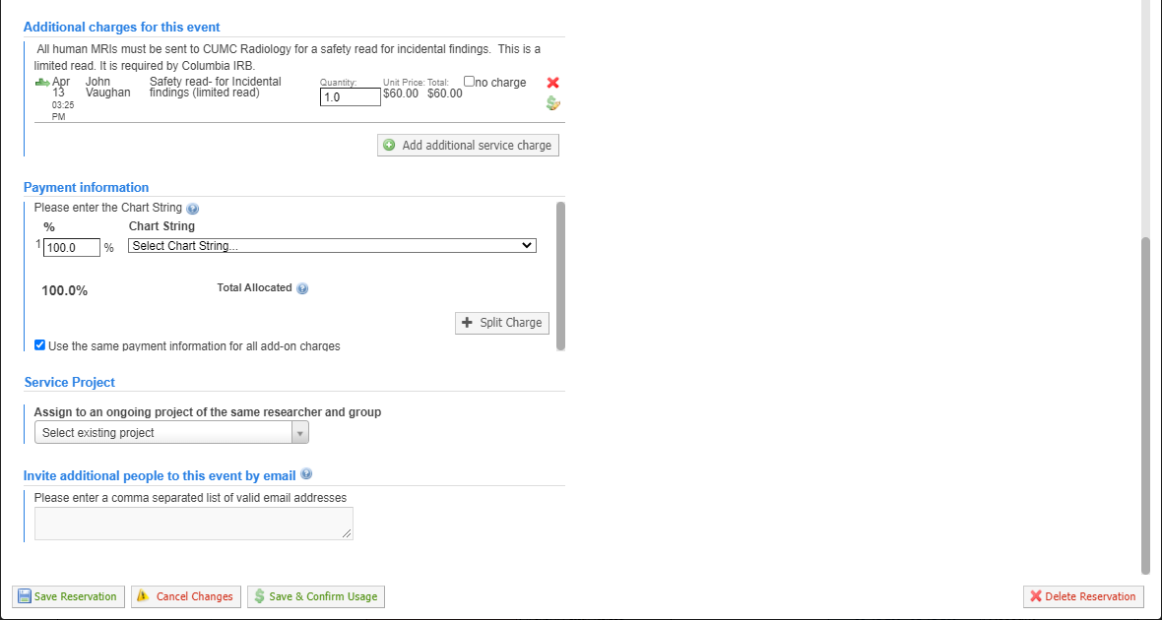
4. When you find a time that works for you and your participant (and the MR technologist if you need him), go ahead and book your time! Click, drag, then unclick right on the calendar to select your block of time.
5. Complete the reservation details.
Notes:
We’ll look at this in 3 chunks.

Slide 11
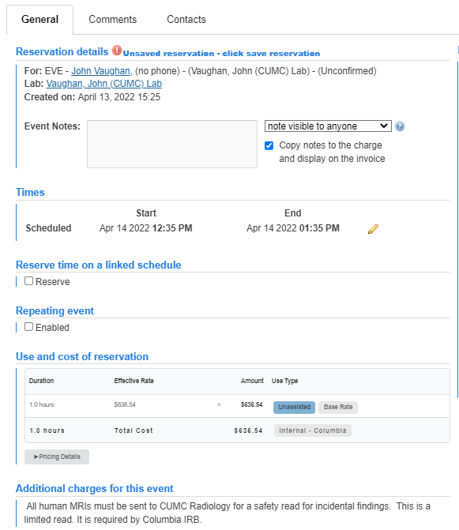
5. Complete the reservation details.
Notes:
Use Event Notes for your own info, if needed. Adjust times if needed; remember to hit save! Ignore “Reserve Time”; this has been disabled on the other calendar so you won’t be able to. Use “Repeating Event” if you want. No one ever has; you could be the first! “Use and cost of reservation” tells you how many hours you reserved and the hourly price you’ll pay.

Slide 12
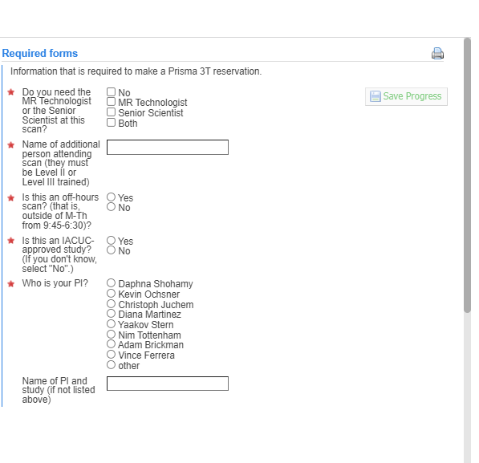
5. Complete the reservation details.
Notes:
Upper right is questions about the people at your scan and your study in general. This is why you need the names of the lab members who will be at the scan. Depending on the answers to some questions, you might get additional questions or prompts. We’ll look at those additional questions now.

Slide 13
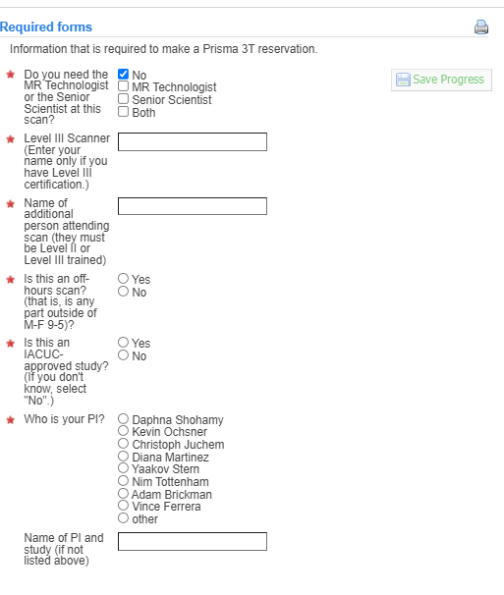
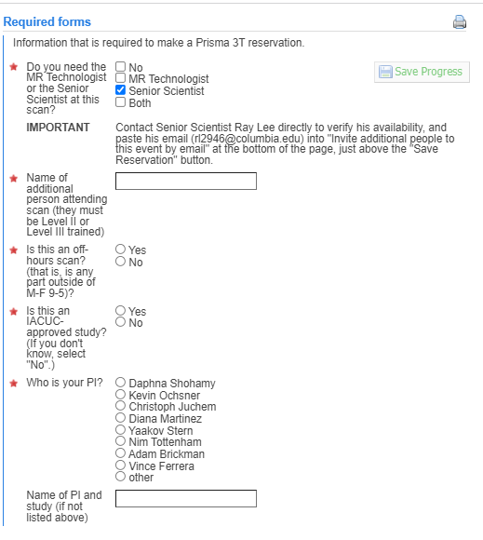
5. Complete the reservation details.
Notes:
For the first question, if you click you do NOT need the MR tech or the senior scientist, it will give you two spaces to enter names: the scan operator’s name, and the person accompanying the scan operator. But if you do need the MR tech or the senior scientist, you’ll get a prompt reminding you to add their email to this reservation. That means they’ll be notified of it. Remember that email address thing; put a pin in it. We’ll come back to it. A common mistake is to enter the MR Technologist or Senior Scientist’s name in this box, but that’s where you enter your name, since it asks who the ADDITIONAL person will be.

Slide 14
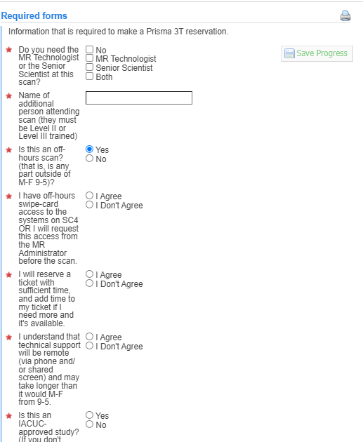
5. Complete the reservation details.
Notes:
If you’re booking an off-hours scan, like an evening or weekend, there are a few extra questions. This is all just to make sure in advance that you have swipe access to the spaces, that you book a reservation that’s long enough, and that any tech support you may need might be a bit slower than if you scanned during a weekday when we’re here.

Slide 15
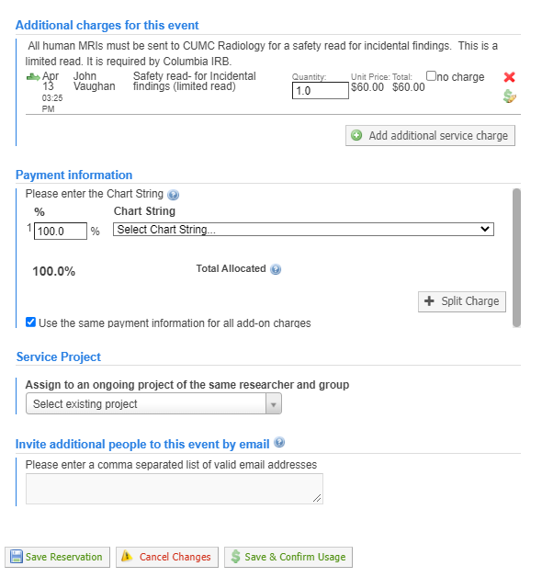
5. Complete the reservation details.
Notes:
Now the bottom half. In “Additional charges” you can see a $60 radiology read. This is required by the IRB for all scans with a human participant. Since the vast majority of scans here have a human participant, the default is to include one rad read on every reservation. But you can change it to zero, or click “no charge” if you’re scanning a mouse or a phantom or hardware. It’s also good if you add extra time. Say, if you booked an hour but you’re running long and need to book an extra half hour on the calendar– be sure to click “no charge”. “Payment Information” is why you need to know which fund will pay for the scan. Service project, I’ve never seen anyone use. Last– this is important– “Invite additional people”. Remember when I told you to copy email addresses from the previous slide? This is where you would paste the email address of either the MR technologist or the Senior Scientist. That’s so important because it’s the only way they’ll know you need to work with them. Always email the Senior Scientist as well.

Slide 16
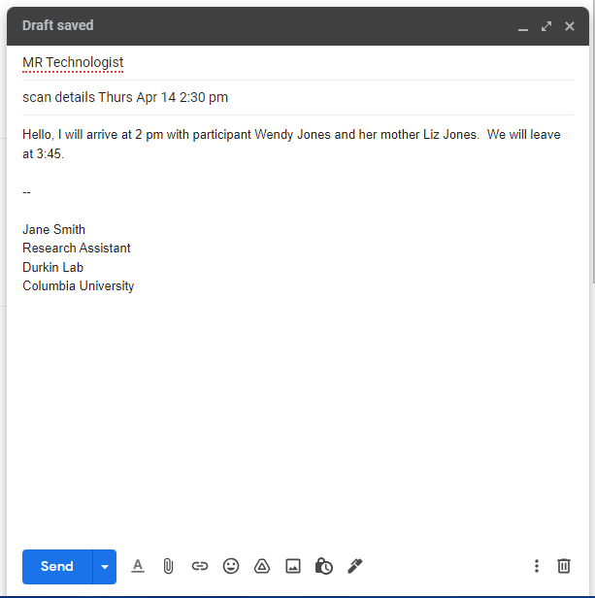
IMPORTANT
6. IMMEDIATELY after booking your scan, email the MR Technologist the names of the participant and the lab member(s) who will be coming to the scan, their arrival time at JLGSC, and their departure time.
Security needs this information for your participant to be allowed in the building. The MR tech compiles that info from all researchers and sends the list to Security in advance.
Do not forget this step! Security has turned people away in the past, when the names weren’t on their list.
Notes:
Our MR technologist is Jonathan Cardona and his UNI is jc5724. This is why you need to have the participant’s name when you book the scan. Include names if any extra people will attend: new lab staff in training, senior lab staff who need to run the task, any companions / parents/ caregivers. When in doubt, assume they will come. It’s better for Security to have that information than not.

Slide 17
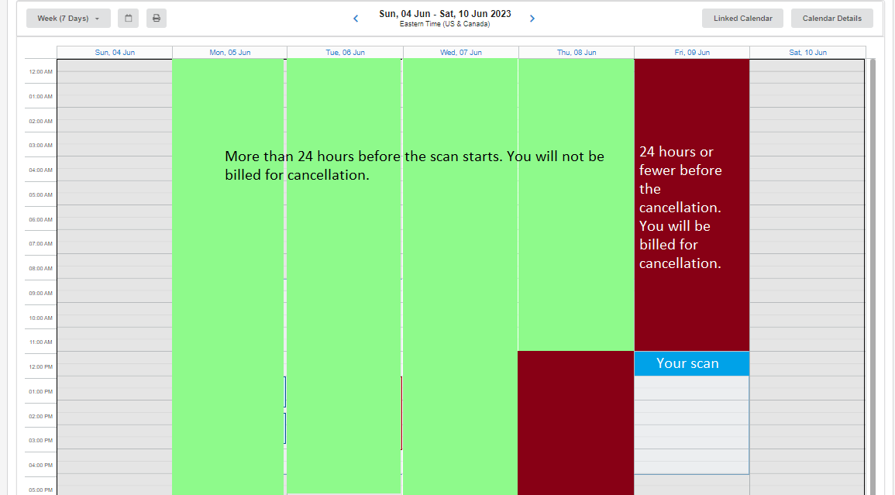
CANCELING A SCAN
There is a 24- hour cancellation policy. That means, to avoid a penalty, cancel your scans 24 hours or more in advance of the scan’s start time.
When you have to cancel within the 24 hours before the scan, you will be billed the hourly price. But there are a few situations and options where you won’t be billed.

Slide 18
CANCELING A SCAN <24 HOURS IN ADVANCE
Cancellation Reason | Will I be Billed?
Participant was a no-show. | Yes.
Participant was claustrophobic and decided to not get scanned. | Yes.
Participant has metal in their body and couldn’t be scanned. | Yes.
Forgot to give participant name to MR tech; Security wouldn’t let them in. | Yes.
Equipment malfunction: your own lab equipment | Yes.
Equipment malfunction: MR Platform equipment | No IF you email details to MR Administrator.
Severe weather | No IF you email details to MR Administrator.
Researcher or participant got sick. | No IF you email details to MR Administrator.
Notes:
In some cases, the billing status depends on the situation. Here are the most common situations. But even with the top 5 situations, where you would expect to be billed, there are a few “outs”. Email me when this happens. It’s the only way I’ll know to adjust the billing details and waive the costs. I really want the billing to be correct.

Slide 19
CANCELING A SCAN <24 HOURS IN ADVANCE
Cancellation Situation | But | Will I be Billed?
Participant was a no-show. OR Participant was claustrophobic and decided to not get scanned. OR Participant has metal in their body and couldn’t be scanned. OR Forgot to give participant name to MR tech; Security wouldn’t let them in. OR Equipment malfunction: your own lab equipment | We cancelled the scan, and another user booked a scan that took the time we cancelled. | Yes. No! The charge is waived.
 | We cancelled the scan, and we or another user booked a scan that took part of the time we cancelled. | Yes. No! The charge is waived.
 | We cancelled the scan, and we have a “forgiven” to use. | Yes. No! The charge is waived.
Notes:
Every study gets a number of “forgivens”, equal to 5% of your total anticipated number of scans.
But the really important part of this slide is in each cell of the middle column: “We cancelled the scan”. If you don’t cancel it, I can’t apply a “forgiven”. If you don’t cancel it, there’s no way another person can take that time. Part of the reason we have a “forgivens” policy is to motivate you to cancel scans you won’t use. People need to know that time isn’t going to be used. They have to know it’s available. Researchers forget this a lot; it’s the #1 reason people pay more than they should. It’s easy to forget. You probably have a lab event calendar and your personal calendar. You delete the canceled scan off those, and it seems to be “gone”, so it’s easy to forget to also cancel it in iLab. But remember, the iLab calendar is the one that automatically takes a chunk of your grant every month.

Slide 20
MOVING A SCAN
Not really a thing. Instead, you would cancel and book the new time. Remember the 24- hour cutoff.
What if you want to move a scan and you are within the 24-hour window before the scan?

Slide 21
MOVING A SCAN <24 HOURS IN ADVANCE: SECRET LOOPHOLE
Cancellation Situation | But | Will I be Billed?
Participant was a no-show. OR Participant was claustrophobic and decided to not get scanned. OR Participant has metal in their body and couldn’t be scanned. OR Forgot to give participant name to MR tech; Security wouldn’t let them in. OR Equipment malfunction: your own lab equipment | We cancelled the scan, and another user booked a scan that took the time we cancelled. | Yes. No! The charge is waived.
 | We cancelled the scan, and we or another user booked a scan that took part of the time we cancelled. | Yes. No! The charge is waived.
 | We cancelled the scan, and we have a “forgiven” to use. | Yes. No! The charge is waived.

Slide 22
MOVING A SCAN <24 HOURS IN ADVANCE: SECRET LOOPHOLE
If your new time overlaps your old time after you cancel and book your new scan, there will be no cancellation fee.
If it does not overlap, you will have to pay the cancellation fee.

Slide 23
Common iLab Questions
How can I book pilot time?
I am Level II. Why can’t I see any calendars in iLab?
I am Level II. Why do I get an error message when I try to book weekend time?
Notes:
You don’t! I do. No user is able to book free time. Email me the date, time, duration, and magnet, and I will take care of it. You must be sure to verify that Jonathan Cardona is available for your pilot scan.
Calendar access is by request, not automatic, after a person gets Level II. Just ask me and I can set it up.
Level II users can only book M-F 9-5 when the MR technologist is available. It’s a safeguard to ensure there will always be a scan operator at each scan. If the technologist agreed to run a weekend scan for you, let me know, and I can book it for you. If a lab member is a Level III operator, they will be able to book weekend or evening time.

Slide 24
Common iLab Questions
What if I book 2 hours but only need 1.5 hours?
What if I book 1 hour but actually need 1.5 hours?
What if the group ahead of me is running late?
I have a weekend scan I need to cancel. Does that also have a 24- hour cancellation period?
Notes:
This would be considered a very last-minute cancellation for the unused half-hour. To make that half-hour available, you would need to email the MR Administrator and ask them to change your reservation during your scan. If another group signs up for the half-hour, you won’t have to pay for it. But if no one signs up for the half-hour, you will have to pay for it.
If there’s room on the calendar for you to add time AND still have at least 15 min open before the next scheduled scan, you must log into iLab and book that block of time. This is the only way to ensure your scan will not be interrupted. If there is a group scheduled to use the scanner right after your scan’s 15 min post scan buffer, you must finish when your reservation ends.
They must stop on time. If they ask to keep scanning, you should feel free to say no.
Weekend cancellation policies are the same as weekday. Yes, it’s a 248-hour cancellation period.

Slide 25
Common iLab Questions
We didn’t do a scan that day, but I see we were billed on the invoice.
We did a pilot scan, which should be free, but we were billed. Why were we billed?
I had a 1 hour scan. The room was empty so I started 30 min early and finished 30 min early. I only used 1 hour. Why was I billed for 1.5 hours?
Notes:
Did you book a scan and forget to cancel it? Always cancel scans if you won’t use them, even if it’s one minute before it starts. This frees up the magnet for another user AND I might be able to waive the cancellation fee. If you hadn’t booked a scan at all, email me to see what happened.
Did you book your own pilot scan? The system will bill you the full price. Be sure to ask me to book pilot scans. Email me if this happens so I can give you a refund.
Starting early is not allowed, even if the room is empty. Book the time you need, and use the time you book. You can cancel and rebook the scan, if you want to start early and only be billed for one hour. The problem is, by starting 30 min early but NOT changing your reservation, you blocked other users for using the space for 1.5 hours. That’s billable time.

Slide 26
iLab: Mutual Interests
Your Part | My Part
Use the time you book; don’t start early or run over | Adjust billing or issue refunds as needed, for 100% accuracy
Cancel in iLab when you won’t be using the scan slot | Waive cancelled scans when you book a partially-overlapping time or in certain circumstances
Communicate with me when there are issues that may affect billing | Help with any iLab issues ASAP
Notes:
I use iLab to create the monthly usage report I present to the board. This report has to be accurate. So I rely on iLab to accurately report what time has been used. I rely on you to help keep iLab accurate, by using the scan reservations you book and cancelling the scan reservations you don’t need.
By working together, this can work well for all of us. I want iLab to work for you. I will help you however I can. Using iLab correctly, like using the time you book and cancelling the scans you don’t use, makes everything work better for both of us. Your monthly bill is as low as possible, the magnets can be utilized as much as possible, and my monthly reports are as accurate as possible.

